Slide 1
Fundamental Concepts
Liu Cui

Slide 2
Security
What is security?
According to National Institute of Standards and Technology (NIST), Information Security is the protection of information systems from unauthorized activities in order to provide confidentiality, integrity, and availability.
According to NIST, Computer Security is the protection afforded to an automated information system in order to attain the applicable objectives of preserving the integrity, availability and confidentiality of information system resources, includes hardware, software, firmware, information/data, and telecommunication.
Achieving some goal in the presence of an adversary.
Questions like: will the system work when there’s an adversary?
Notes:
Many systems are connected to the Internet, which has adversaries. Thus, design of many systems might need to address security,

Slide 3
Background
Risk
It is a situation involving exposure to danger
Vulnerability
A flaw, loophole, oversight, or error that can be exploited to violate system security policy
Threat
A threat is an event, natural or man-made, able to cause negative impact to an organization
Exploit
An exploit is a defined way to breach the security of an IT system through a vulnerability
Key terms

Slide 4
Background - Types of actors and their motivations
1. Internal Users: They are still the most likely to cause security problems, whether intentional or not.
2. Hackers (for profit or not): They can be attackers that are paid by private or public organization. Or simply someone with enough knowledge and time to bother.
3. “Hackivism”: Similar to government but usually do not have much financial power. Normally they reveal sensitive or confidential information to the public and carry out DDOS .
4. Governments: They have enough power to cause very large financial and operational losses. It is normal to attack infrastructure, spy, etc.
Motivation: play, gain money, political action and movement, show off

Slide 5
High-level plan for thinking about security
Policy: the goal you want to achieve. Common goals (C.I.A):
Common goals: Confidentiality, Integrity, Availability
More Concepts: Assurance, Authenticity, Anonymity
Concepts relating to the people who used information are: authentication, authorization, and nonrepudiation.
Threat model and attacks: assumptions about what the attacker could do.
Eavesdropping
Alteration
Denial-of-services
Masquerading
Correlation and traceback
Mechanism: knobs that your system provides to help uphold policy. e.g. user accounts, passwords, file permission, encryption.

Slide 6
POLICY

Slide 7
Security Policy: Confidentiality
Confidentiality: avoidance of the unauthorized disclosure of information
Providing access for those who are allowed to see it
Disallowing others from learning anything about its content
Tools for protecting sensitive information incorporate the following concepts:
Encryption: the transformation of information using a secret, called an encryption key, so that the transformed information can only be read using another secret, called the decryption key.
Access control: rules and policies that limit access to confidential information to those people and/or systems with a “need to know.”
Authentication: the determination of the identity or role that someone has.
Something you are (human with fingers and eyes)
Something you know (password)
Something you have (radio token with secret keys)
Authorization: the determination if a person or system is allowed access to resources, based on an access control policy
Physical security: the establishment of physical barriers to limit access to protected computational resources.

Slide 8
Security Policy: Integrity
Integrity: the property that information has not be altered in an unauthorized way.
Data integrity can be compromised in computer systems and networks, and these compromises can be benign or malicious:
Benign: crash of disk drive
Malicious: virus
Tools for protecting the confidentiality also help prevent data from being modified in the first place. In addition, there are several tools specifically designed to support integrity (common trait: they use redundancy):
Backups: the periodic archiving of data
Checksums: the computation of a function that maps the contents of a file to a numerical value.
Data correcting codes: methods for storing data in such a way that small changes can be easily detected and automatically corrected.
Both the content of a data file and the metadata for each data file need to be protected!

Slide 9
Security Policy: Availability
Availability: the property that information is accessible and modifiable in a timely fashion by those authorized to do so.
Tools for providing availability:
Physical protections: infrastructure meant to keep information available even in the event of physical challenges (storms, earthquakes, bomb blasts, etc)
Computational redundancies: computers and storage devices that serve as fallbacks in the case of failures.
Redundant arrays of inexpensive disks (RAID) use storage redundancies to keep data available to their clients
Web servers are often organized in multiples called “farms” so that the failure of any single computer can be dealt with without degrading the availability of the web site.

Slide 10
Assurance
In addition to C.I.A., the designers of computer systems want to protect and manage the resources of these systems and they want to make sure users don’t misuse these resources.
Assurance refers to how trust is provided and managed in computer sytems.
Trust involves the interplay of the following:
Policies: specify behavioral expectations that people or systems have for themselves and others.
Permissions describe the behaviors that are allowed by the agents that interact with a person or system.
Protections: describe mechanisms put in place to enforce permissions and policies.

Slide 11
Authenticity
Authenticity is the ability to determine that statements, policies, and permissions issued by persons or systems are genuine. If such things can be faked, there is no way to enforce the implied contracts that people and systems engage in when buying and selling items online.
Formally, we say that a protocol that achieves such types of authenticity demonstrates nonrepudiation.
Nonrepudiation is the property that authentic statements issued by some person or system cannot be denied.
The chief way that the nonrepudiation property is accomplished is through the use of digital signatures (https://www.coursera.org/lecture/cryptocurrency/digital-signatures-bx6si).

Slide 12
Anonymity
Anonymity is the property that certain records or transactions not to be attributable to any individual.
Tools:
Aggregation: combining of data from many individuals so that disclosed sums or averages cannot be tied to any individual.
Mixing: intertwining of transactions, information, or communications in a way that cannot be traced to any individual.
Proxies: trusted agents that are willing to engage in actions for an individual in a way that cannot be traced back to that person.
Pseudonyms: fictional identities that can fill in for real identities in communications and transactions, but are otherwise known only to a trusted entity.

Slide 13
Authentication and Authorization
To make information available to those who need it and who can be trusted with it, organizations use authentication and authorization.
Authentication: is proving that a user is the person he or she claims to be, through something the user knows (such as a password), something the user has (such as a smartcard) or something about the user is (such as a fingerprint.)
Authorization: is the act of determining whether a particular user (or computer system) has the right to carry out a certain activity, such as reading or writing a file as well as running a program.
Authentication and authorization go hand in hand. Users must be authenticated before carrying out the activity they are authorized to perform.

Slide 14
Nonrepudiation
Non-repudiation is the assurance that someone cannot deny the validity of something.
Non-repudiation is a legal concept that is widely used in information security and refers to a service, which provides proof of the origin of data and the integrity of the data.
In other words, non-repudiation makes it very difficult to successfully deny who/where a message came from as well as the authenticity of that message
Digital signatures can offer non-repudiation when it comes to online transactions, where it is crucial to ensure that a party to contract or a communication can’t deny the authenticity of their signature on a document or sending the communication in the first place. In this context, non-repudiation refers to the ability to ensure that a party to a contract or a communication must accept the authenticity of their signature on a document or the sending of a message.

Slide 15
High-level plan for thinking about security
Policy: the goal you want to achieve. Common goals (C.I.A):
Common goals: Confidentiality, Integrity, Availability
More Concepts: Assurance, Authenticity, Anonymity
Concepts relating to the people who used information are: authentication, authorization, and nonrepudiation.
Threat model and attacks: assumptions about what the attacker could do.
Eavesdropping
Alteration
Denial-of-services
Masquerading
Correlation and traceback
Mechanism: knobs that your system provides to help uphold policy. e.g. user accounts, passwords, file permission, encryption.

Slide 16
Threats and Attacks

Slide 17
Security Threats Classification
Threats
Human Factors
Internal Factors
External Threats
Natural Factors
Lightening, Hurricane, Tornado, Tsunami
Former Employees
Current Employees
Malicious Events, Hackers or Crackers, Viruses, Trojan， and worms

Slide 18
Security Attack Classification
Attack
Passive Attacks
Eavesdropping
Traffic Analysis
Active Attacks
Masquerade
Replay
Modification
Denial of Services

Slide 19
Vulnerability Assessment
A vulnerability assessment is a search for these weakness/exposures in order to apply a patch or fix to prevent a compromise.
How do these weakness occur?
Many Systems are shipped with known and unknown security holes and bugs, and insecure default settings
Many vulnerabilities occur as a result of misconfiguration by system administrators

Slide 20
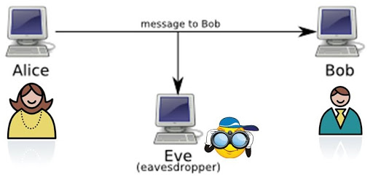
Passive Attacks: Eavesdropping
Eavesdropping: The interception of information intended for someone else during its transmission over a communication channel.
Packet sniffers: monitor nearby Internet traffic. Wireshark
Countermeasure:
access control
Secure the area
encryption
Who might Bob and Alice be?
Real person
Client and Server (web-browser and web server, parking meter with remote server, etc)

Slide 21
Passive Attack: Traffic Analysis
Traffic analysis is the process of intercepting and examining messages in order to deduce information from patterns in communications.
It can be performed even when the messages are encrypted and cannot be decrypted.
We call this type of attack “side channel attack”
Example of side channel attack
The shape of the traffic
Battery consumption
The integration of multiple data sources and information flows to determine the source of a particular data stream of piece of information.

Slide 22
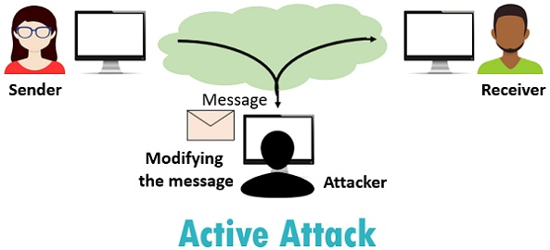
Active Attacks: Modification
Alteration: unauthorized modification of information
Man-in-the-middle attack: a network stream is intercepted, modified, and retransmitted, and computer viruses, which modify critical system files so as to perform some malicious action and to replicate themselves.
Alteration is an attack on data integrity.
Countermeasures:
Encryption
passwords

Slide 23
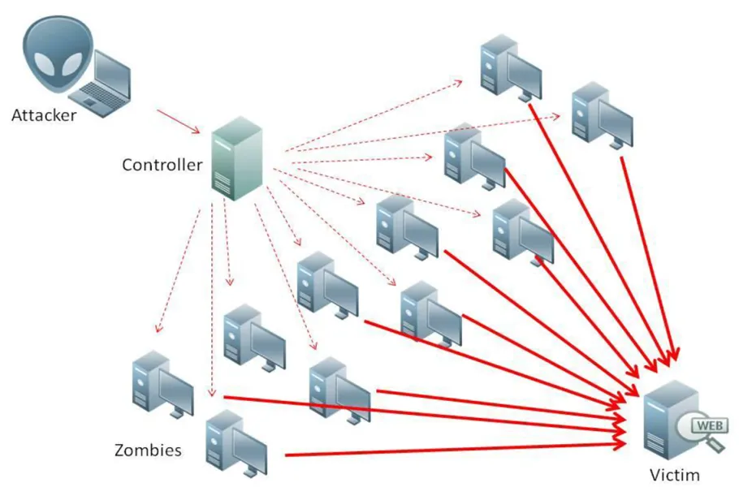
Active Attacks: Denial-of-service
Denial-of-service: the interruption or degradation of data service or information access.
Email spam: fill up a mail queue and slow down an email server
DDOS
Countermeasures
Strong anti-virus and anti-spyware software
File and folder hashes on system files
Reverse DNS lookup to verify the source
External firewall

Slide 24
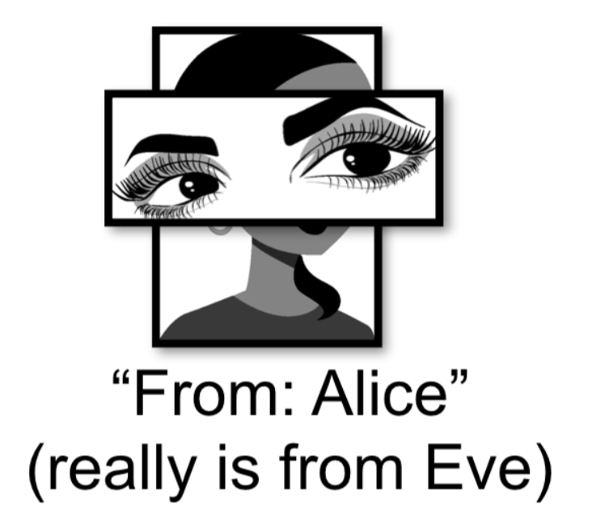
Active Attacks: Masquerading
Masquerading: the fabrication of information that is purported to be from someone who is not actually the author.
Phishing: creates a web site that looks like a real bank or other e-commerce site, but is intended only for gathering passwords.
Spoofing: may involve sending on a network data packets that have false return addresses.
Masquerading is an attack on authenticity, and in the case of phising, an attempt to compromise confidentiality and/or anonymity.
Countermeasures:
Training and stay alert

Slide 25
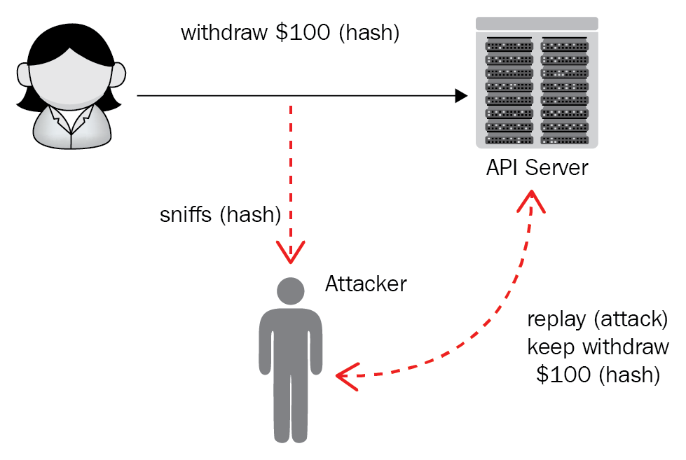
Active Attacks: Replay
Repudiation: the denial of a commitment or data receipt.
This involves an attempt to back out of a contract or protocol that requires the different parties to provide receipts acknowledging that data has been received.
This is an attack on assurance.

Slide 26
High-level plan for thinking about security
Policy: the goal you want to achieve. Common goals (C.I.A):
Common goals: Confidentiality, Integrity, Availability
More Concepts: Assurance, Authenticity, Anonymity
Concepts relating to the people who used information are: authentication, authorization, and nonrepudiation.
Threat model and attacks: assumptions about what the attacker could do.
Eavesdropping
Alteration
Denial-of-services
Masquerading
Correlation and traceback
Mechanism: knobs that your system provides to help uphold policy. e.g. user accounts, passwords, file permission, encryption.

Slide 27
Security Mechanisms—Cyber Defense Tools, Methods and Components
Combination of hardware, software, and process
That implement a specific security policy
e.g., Protocol suppression, ID and authentication
Mechanism are security services to enforce security policy
Resulting goal: No way for adversary within threat model to violate policy.

Slide 28
Why is security so hard?
Need to guarantee policy, assuming the threat model.
Difficult to think of all possible ways that attacker might break in.
The solutions can be very complex
The solutions can be attacked themselves
Know what to do, but where to implement them?
Realistic threat models are open-ended
Iterative process: design, update threat model as necessary, etc.
No one likes security until its needed
Protectors have to be right all the time

Slide 29
Why security is SO hard?
Today’s cybersecurity challenges:
Threats increase
Alerts increase
Needed knowledge increase
Available analyzers decrease
Available time decrease

Slide 30
What’s the point if we can’t achieve perfect security?
Each system will likely have some breaking point leading to compromise.
Doesn’t necessarily mean the system is not useful: depends on context.
Important to understand what a system can do, and what a system cannot.

Slide 31
In reality, must manage security risks vs. benefit
More secure systems means less risk (or consequence) of some compromises.
Insecure system may require manual auditing to check for attacks, etc.
Higher cost of attack means more adversaries will be deterred.
Notes:
Better security often makes new functionality practical and safe. Suppose you want to run some application on your system. Large companies sometimes prohibit users from installing software that hasn’t been approved on their desktops, partly due to security. Javascript in the browswer is isolated, making it ok (for the most part) to run new code/ applications without manual inspection/approval (or virtual machines, or Native Client, or better OS isolation mechanisms). Similarly, VPNs make it practical to mitigate risk of allowing employees to connect to a corporate network from anywhere on the Internet.

Slide 32
Cybersecurity Principles
Separation:
Domain separation: Separating areas where resources are located prevents accidents and loss of data, keeping information worlds from colliding
Process isolation: Keeping processes separate prevents the failure of one process from negatively impacting another
Resource encapsulation: hardware, system objects, or processes must be separated and used as intended
Modularization and Layering
Modularization: Able to be inserted or removed from a project. Each module has its own function, interchangeable with other modules.
Layering: Multiple layers of defense protect information.
Confidentiality
Information hiding: Any attempt to prevent people from being able to see information
Least privilege: Limits what access people have to your resources and what they can do with them.
Simplicity

Slide 33
Summary
What is meant by security?
The term “security” is used in the sense of minimizing the vulnerabilities of assets and resources.
An asset is anything of value
A vulnerability is any weakness that could be exploited to violate a system or the information it contains
What is to be protected?
Information and data
Communication and data process services
Equipment and facilities

Slide 34
Summary
Threats
The threats to a data communication system include
Destruction of information and/or other resources
Corruption or modification of information
Theft, removal or loss of information and/or other resources
Disclosure of information
Interruption of services
Accidental threats do not involve malicious intent
Intentional threats require a human with intent to violate security
If an intentional threat results in action, it becomes an attack

Slide 35
Summary
Attack
An attack is an action by a human with intent to violate security
It does not matter if the attack succeeds.

